Slide 1
Data Centralization and Unified Pricing

Slide 2
01
02
03
Our Understanding
Proposed Approach
Indicative Timelines & Resource Mix
04
05
Discovery Questions
Success Stories

Slide 3
01
Our Understanding

Slide 4


Our Understanding
Objective : Creating a standardized and unified central product data repository for blanket pricing model
Current State
Centralized Repository : Centralization of Data into one single source of truth for price analytics
Data Standardization : Standardization of languages to one. Enriched Data points to unlock maximum information.
Value Driving Business Insights: Insights into price impacts to sales, product attributes and cost of development etc.
Unified Pricing Model : Categorization of products into specific categories as per business logic and a pricing model that accounts for product type, historical price response and current demand
Desired State
Client is a paper manufacturing company with multiple plants spread across Europe.
Each Plant has its own pricing model and data storage systems.
Client wishes to create a unified pricing model that shall take into account the products of every plant and the nuances associated with each location
However,client facing issues with regards to data unification as the languages differ from plant to plant and some important data points for example Product descriptions are incomplete

Slide 5
02
Solution Approach

Slide 6





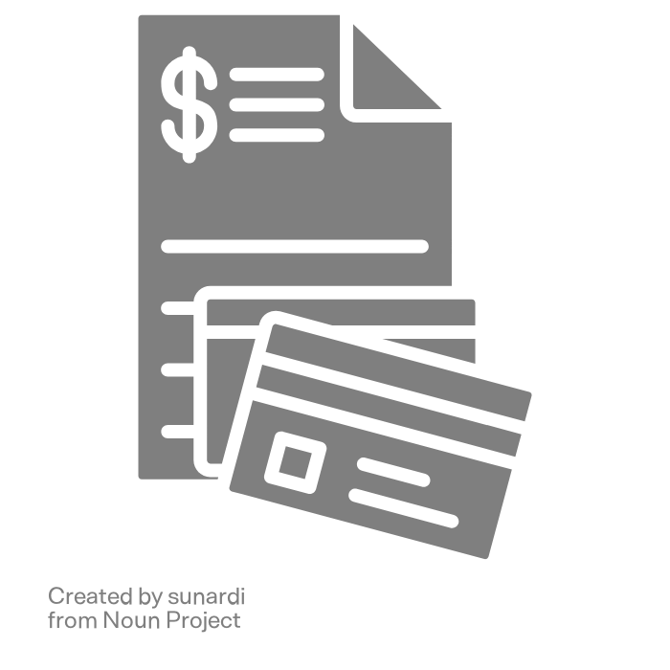
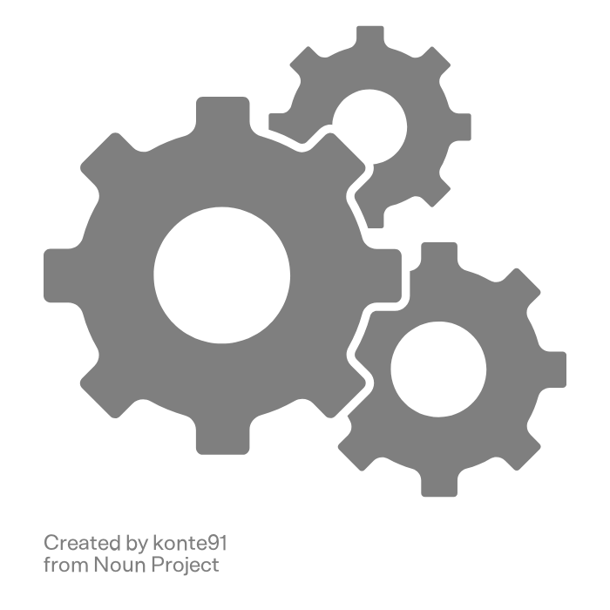
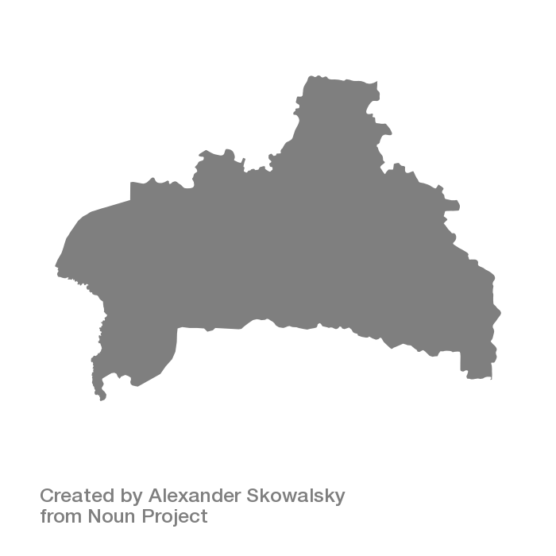
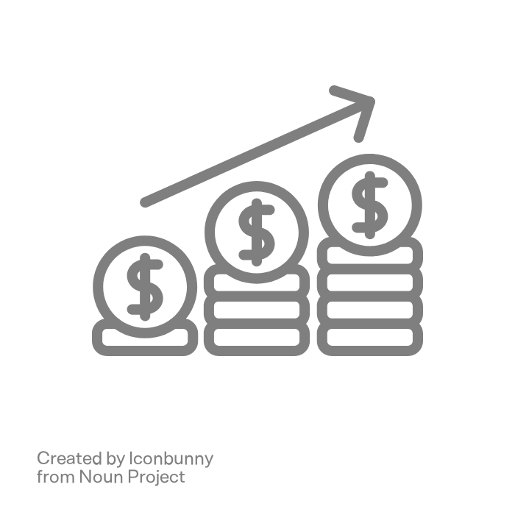

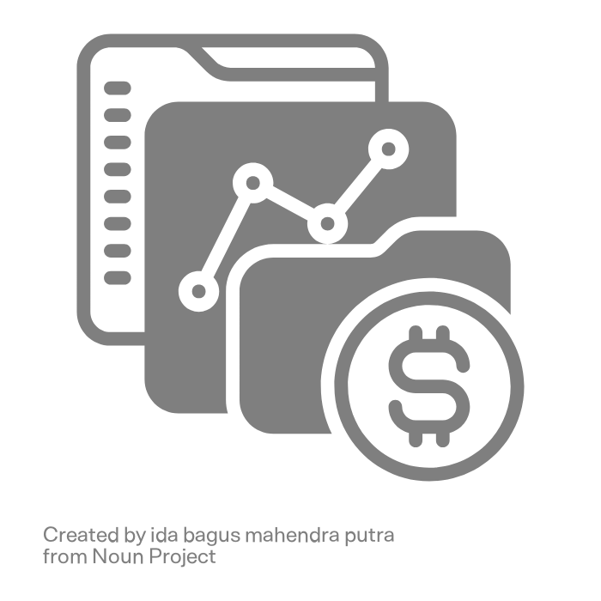

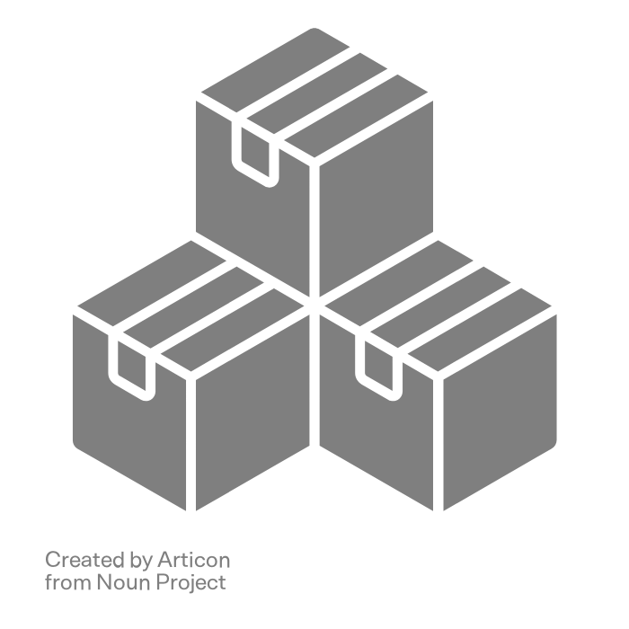
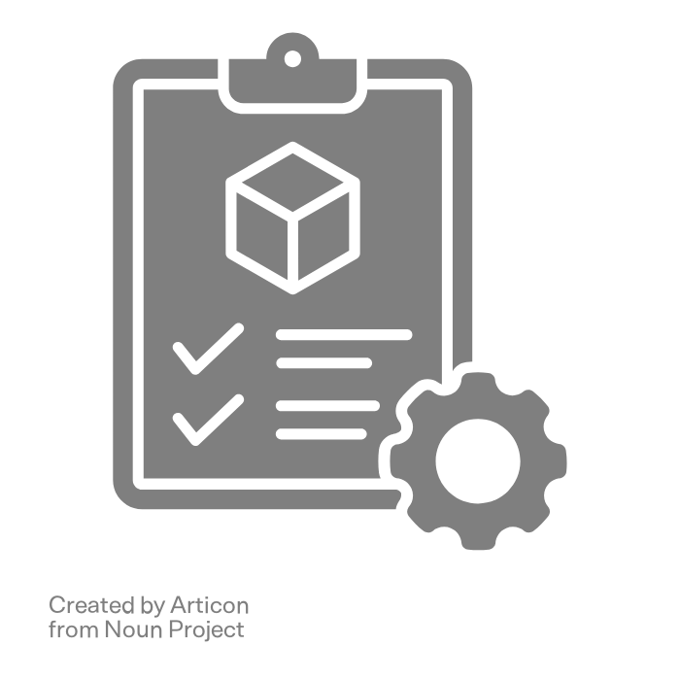
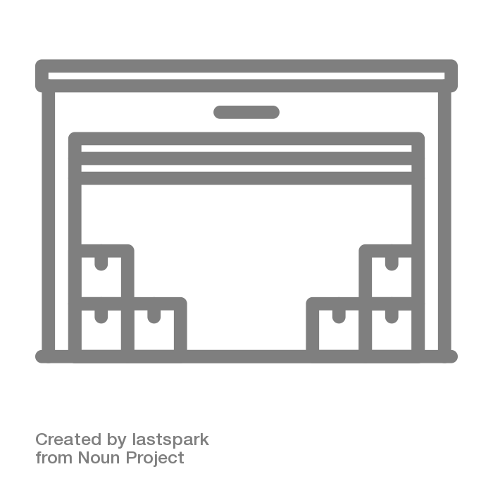
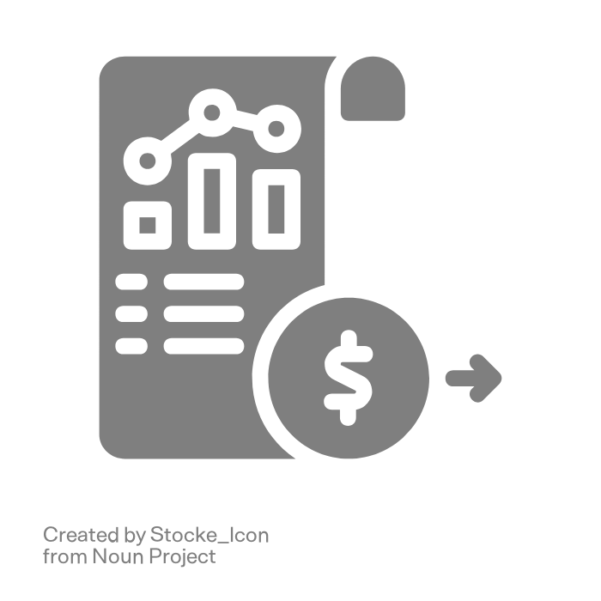
Proposed Solution : Data Sources
Product Level Data
Product Specifications & Build Material
Product Descriptions
(Any language)
Product SKUs / Product IDs
Historical Marketing/Sales Enablement Collaterals
Plant Level Data
Plant Location and Equipments
Bills Of Materials
(Cost Of Goods)
Historical
Product Level Production
Product Distribution/ Sales Area
Historical Pricing & Sales Data
Historical Sales and Sales Rate
Profit Margins
Historical Discounts/Offers
Information
Historical Prices
Inventory Data
Current Inventory
Historical Inventory Data
Storage Costs
Lead Costs

Slide 7










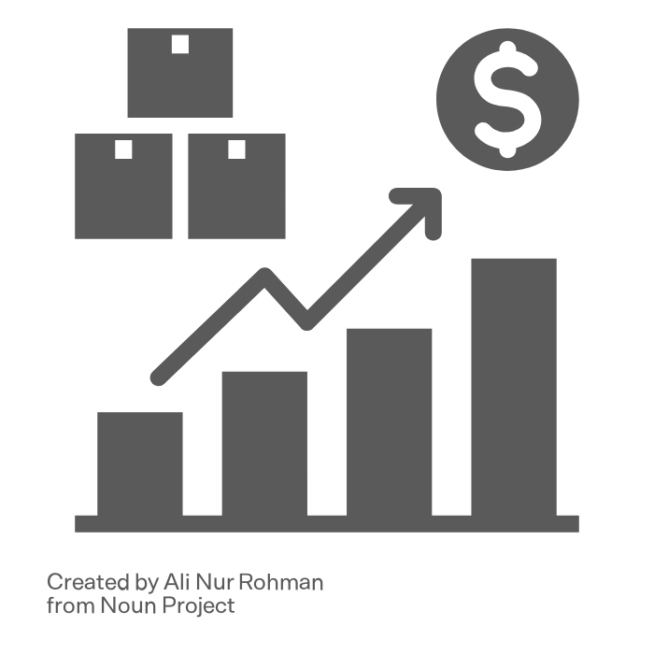
Proposed Solution : Overall Indicative Approach
Data Onboarding
Data Processing
Analysis Layer
Indicative Insights
Data Unification And Transformation
Product Segmentation
Pricing and Corresponding Sales
Product Level Data
COGS And Pricing
Plant Level Data
Data Translation
Pricing Model on the basis of Product Specification ,Projected Demand , Production and Business Logics
Historical Pricing & Sales Data
Region Wise Sales Analysis
GCP
Missing Data Handling
Insight Mining
Inventory Data
Sales Velocity And Inventory Lead Insight
From Every Plant

Slide 8









Proposed Solution : Overall Indicative Architecture
Data Onboarding
Data Processing
Analysis Layer
Insights
Product Level Data
Dataflow
Unified Pricing Model
Vertex AI
Dataproc
Plant Level Data
Data Transformation, Unification and Language Standardization
Historical Pricing & Sales Data
Raw Data Dump on a Data Warehouse
(BigQuery)
Master Table(s)
(BigQuery)
Insight Mining
Cloud
Translation API
Product Description Completion Module
Inventory Data
Cloud Functions
From Every Plant
Data Transfer

Slide 9


Proposed Solution : Indicative Architecture For Product Description Completion Module
Deeper look at Product Description Completion Module from Data Preprocessing Stage
Historical Sales Enablement/ Marketing Collaterals
Cloud Storage
Vector Embeddings By Vertex AI Models and Storage in Vector Search
Dataflow
Product Description Generator
Cosine Similarity Search
Cloud Functions
Completed Product Description
Cloud Functions
Product Description & Attributes
Classification Flag Complete/Incomplete
BigQuery(Raw)
BigQuery Staging Table
Dataflow
Cloud
Translation API
Classification Job Incomplete/Complete Description
Language Standardization

Slide 10
Proposed Solution : Indicative Architecture For Product Segmentation
Deeper look at Product Segmentation Module from Analysis Layer
Classification (Pre defined Categories as per business logics As Label) OR Clustering ( No predefined Labels)
Indicative Potential Product Categories
Historical Pricing & Sales Data
Product Size And Specification
Build Material
Product Level Data
Data Transformation, Unification and Language Standardization
Cost Of Production and Equipment
Raw Data Dump on a Data Warehouse
(BigQuery)
Master Table
(BigQuery)
Plant Level Data
Rule Based Division
Top Selling And Top Produced

Slide 11
03
Indicative Timeline & Resource Mix

Slide 12
Proposed Resource Mix
1 Senior
Engagement Manager
1 Associate Data Architects
3
Junior ML Engineers
Indicative Timeline
16 to 18 Weeks
1
Cloud Platform Engineer
4
Senior Data Engineers
3
Senior ML Engineers
Indicative Costs
4
Junior Data Engineers
TBD
Note : We will be Able to disclose the exact resource mix and the associated costs post getting better clarity from the discovery questions

Slide 13
Indicative Timeline
WK 1 | WK 2 | WK 3 | WK 4 | WK 5 | WK 6 | WK 7 | WK 8 | WK 9 | WK 10 | WK 11 | WK 12 | WK 13 | WK 14 | WK 15 | WK 16 | WK 17 | WK 18
GCP set Up & Discovery
Data Pipeline Development
Data Preprocessing : Cleaning, Transformation & Unification
Project Kick off
Project Handover
Data Preprocessing : Language Standardization
Data Preprocessing : Product Description Completion Module development , testing and deployment
Pricing Model development
Insight Mining
TDD And Handover

Slide 14
04
Discovery Questions

Slide 15
Discovery Questions : To Help Us Craft The Exact Scope
General | Could you help us understand the number of plants that you would want to us to consider for this engagement?
 | Roughly how many languages would we be dealing with, which language would you want us to use as the standard ?
Data | What would be the storage layers for the datasets associated with each plant? Is your data on Prem or on Cloud?
 | Is your data stored in structured or unstructured format?
 | What would be the total data size for the historical data ? Is there a preferred incremental batch ingestion frequency would you want us to consider?
 | For missing product descriptions, are there any referential data we could leverage? Maybe collaterals around marketing, web content or internal sales training material?
Analytics Layer | For business insights what would be your preferred Business Intelligence tool? For example Qlickview,
 | For centralized pricing model, what would be the required frequency of inference?

Slide 16
THANKS!

